Slide 1

Hackathon Survival Guide
A short and entertaining look at what to do, and more importantly what NOT to do, at your first hackathon.

Slide 2
Objectives
Provide you with some tips on how get and stay organized.
Provide you with some tips on what to do, and not to do, at the event in order to be the most successful.
Try not to be just another boring corporate presentation.

Slide 3
Observations
A lot of teams struggle during hackathons, often due to:
Poor organization
Poor planning
Conflicting personal goals
You can easily spot these struggling teams, because they exhibit some predictable behavior...

Slide 4

“Can we please use {new tech}, it's soooo cool!”

Slide 5

“I just want to get coding already!”

Slide 6

“Somebody just pick a stupid {tech}!!!”

Slide 7

“I don’t even know where to begin...”

Slide 8

“I got this. Go find something else to do...”

Slide 9

“I thought you were doing that...”

Slide 10

“I can’t do anything until {person} is done with {task}”

Slide 11

“... I’m out.”

Slide 12
These are all symptomatic of
failing to plan and organize according to your team’s goals.

Slide 13

Plan your work. Work your plan.
Words to live by

Slide 14
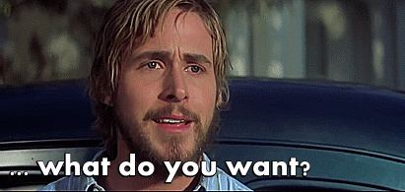
Goal setting: what do you want out of this
Goal setting is critical. You need to decide on what you want to get out of the event, as it will drive much of your behavior and decisions.
In our experience there are three main motivations for people who attend hackathons, and they exhibit some predictable behavior:
🎓 To learn new things
🎉 To meet people or have fun
🏆 To win something

Slide 15
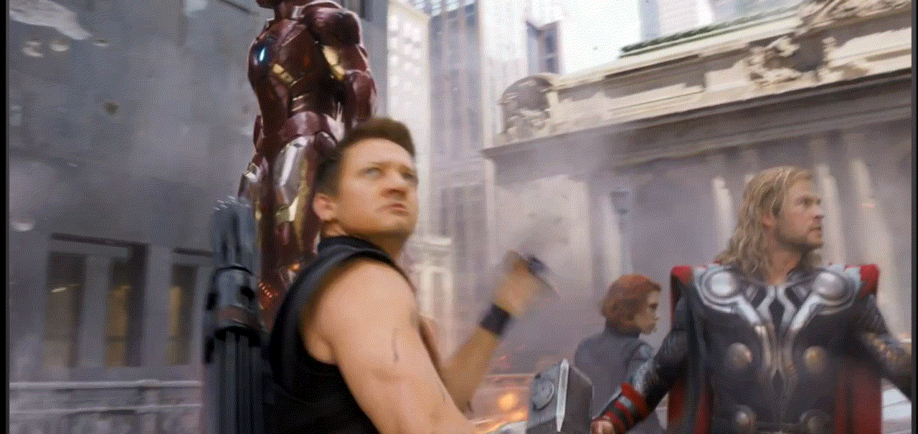
Organize your team
With goal setting out of the way, now you need to decide on how you are going to organize your team.
Pick a leader - to speak on behalf of the team, settle disputes, remove roadblocks, and set direction.
Pick a time keeper - that will keep you on task and schedule.
Regroup and do it often. Quick cycle time is an important advantage.
One person can serve in multiple roles
You should change roles around as needed

Slide 16
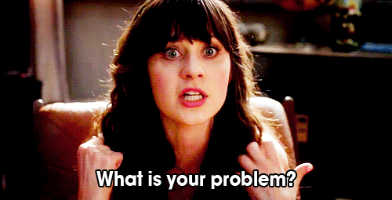
Define your problem
Write a brief description of the issue(s) to be addressed. It aids in defining the scope of work by setting some boundaries, and helps ensure that everyone is on the same page.
It should have at least two components
Description - A clear and specific overview of the current state of things.
Success criteria - How exactly will you know you have solved the problem?
Be careful not to jump straight to solutions yet!

Slide 17
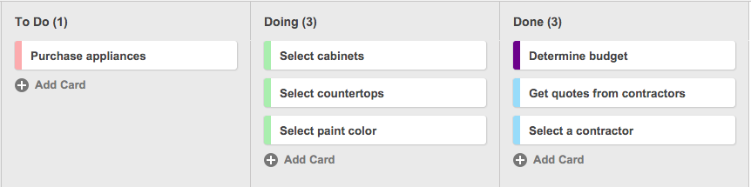
Organizing your work with Kanban
Kanban is a method for visually managing work. This approach presents all participants with a full view of the development process from task definition to delivery, with care taken to balance the demand for work to be done with the available capacity to start new work.
https://leankit.com/learn/kanban/kanban-board/
Work moves from left to right
Queue limits
https://www.atlassian.com/agile/kanban
https://leankit.com/learn/kanban/kanban-board

Slide 18

We now have a solid attack plan!
We know what we want
We organized ourselves
We got our Kanban board set up
We broke out tasks and features
Agreed on when to regroup

Slide 19
Pro tips
Tips, tricks, and cautionary tales from some pros

Slide 20

Not using source control is dangerous
Seriously, I’m not joking. Use it!

Slide 21
Get your git together.

Slide 22
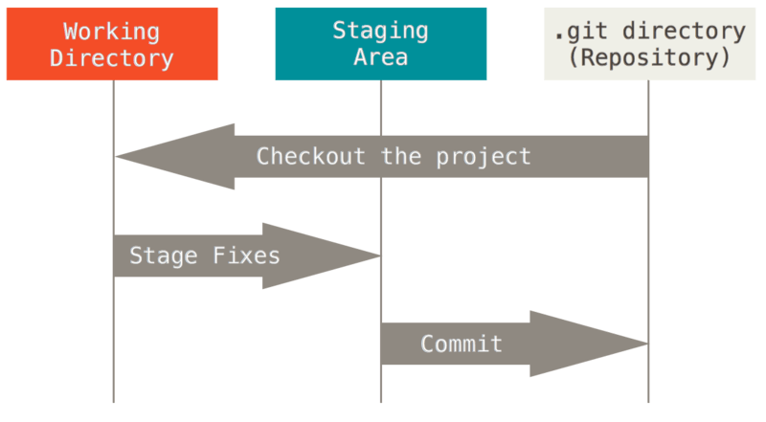
What is git ?
Distributed version control system
Track changes
Reverting / Undo
Initial Configuration
Github.com
git config --global user.email
Ps. Don’t send your API keys, DB passwords, etc to git! See also: gitignore

Slide 23

A simple git workflow
Working with git doesn’t have to be hard. Using a simple centralized workflow gets the entire team up and running in a few minutes.
If you have never used git before, go here: https://try.github.io
# Suggested Workflow git add . git commit -m ‘This is my commit’ git push git pull

Slide 24
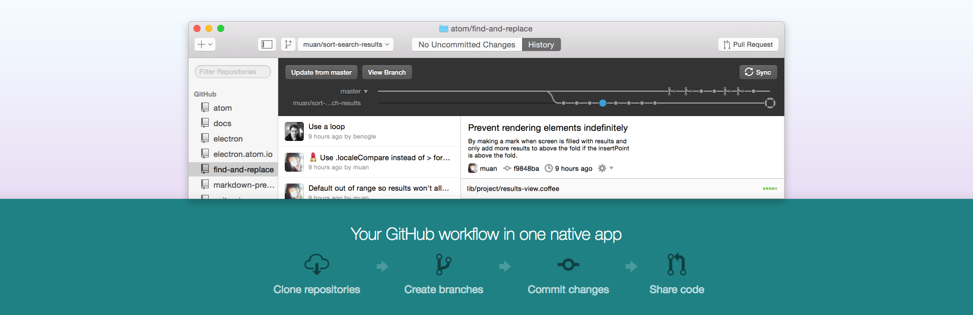
GUI for git
Not comfortable with using the command line? That's okay, not everyone is. That’s why there are GUIs! → https://desktop.github.com/

Slide 25
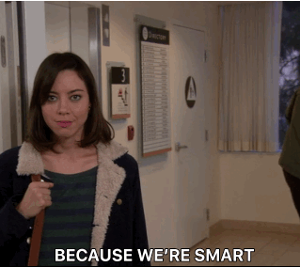
Work smarter, not harder
It’s about how much you get done, not how hard you worked.

Slide 26
Find the right tools for the job
Whatever you do, try not to code every little thing from scratch. You need to be focused on solving your business problems, not reinventing the wheel. You can get up and running quickly, easily, and securely, by using common tools and frameworks.
No idea where to start? No idea which {thing} is better at {task}? Ask your friendly neighborhood SME! Or, take a look at what the broader community thinks...
Find a framework for:
Java, Python, PHP, Perl, JavaScript, HTML/CSS, etc…
You’ll get:
Lots of help online
Better results in less time
A starting place for SMEs to help
You don’t have to take our word for it:
http://hotframeworks.com/
https://www.keycdn.com/blog/web-development-tools
http://www.bestwebframeworks.com/

Slide 27

Develop locally, deploy remotely
It insulates you from danger.

Slide 28
Our suggested workflow
Your machine
WRITE AND TEST CODE
Server (optional)
2. git COMMIT
4. DEPLOY
3. git PUSH AND PULL

Slide 29
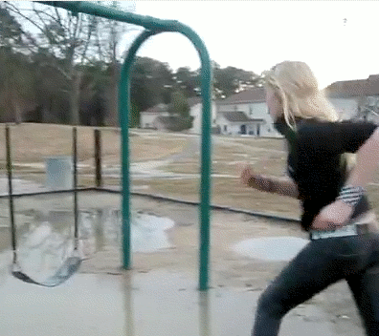
Fail fast, fail hard,
and move on.
When you fail, you learn.

Slide 30
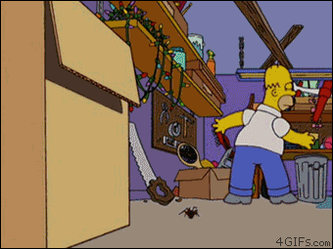
Uh oh, something isn’t working!
I’m stuck. Now what?

Slide 31
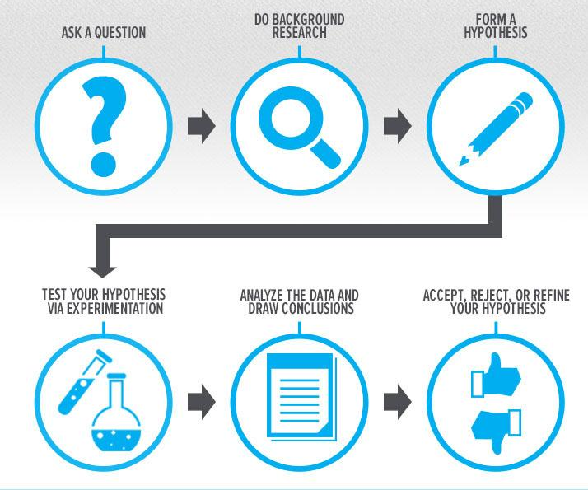
Scientific Method to the rescue!
Understand the situation
Got an error? What does is say?
Identify the root cause of the problem
Change something recently? Revert!?
Develop an effective action plan
Got an idea? Decide how you are gonna test it!
Execute and modify, until the problem is solved.
Run your test, evaluate the result, modify as needed, test again.
P.S. Be a good teammate. Only commit stable code to Git!

Slide 32

Still stuck? Ask for help!
Needing help doesn’t make you a failure, it makes you human.

Slide 33

Don’t neglect the presentation!
It’s as important as your code.
Remember the 5 B’s:
Be prepared
Be focused
Be concise
Be interesting
Be honest

Slide 34


